Slide 1
AI Devops (Cardiovascular Disease Predictor)
By: Yeo Sheen Hern (1902257)
Cardiovascular disease is the number one cause of death globally
Web App servers as an early warning system for high risk individuals
Users who have a high probability of having cardiovascular disease can get a proper check up before it's too late

Slide 2

Devops Process (Gitlab)
Planning with Scrum Board.
Created PBIs for features that should be completed, working towards pushing the ‘CA1 Product’. Updated accordingly whenever completed. Organised planning and work towards goal.
Source Control with Gitlab for creating web app.
Used git bash with gitlab for source control. Made a new branch for ever new feature that was to be completed. And merged into master(prod) when completed.

Slide 3
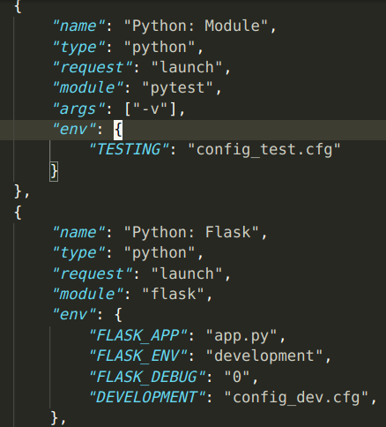

Devops Process (Gitlab)
Dev/Testing/Deployment Environments
Created three different environments to for development, testing and deployment respectively.
For Development, we used an sqlite database
For Testing, we used memory to run all our tests.
Finally for Deployment, we used postgreSQL with heroku.

Slide 4
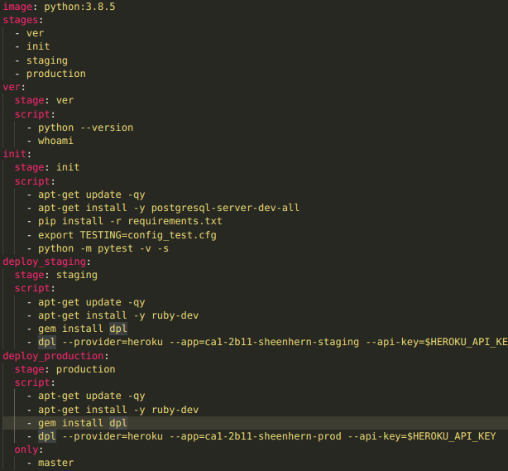
Devops Process (Gitlab)
CI/CD with Gitlab (Heroku app)
Used Heroku with gitlab CI/CD features to configure environment, run automatic tests, and deploy on to staging and prod heroku apps.
Every push will automatically run yaml script to configure environment and deploy on staging heroku app.
When a feature is finished and verified ready for production, we merge to master, which will deploy the app to our prod heroku app.
This allows for continuous development where we can test on our staging app and still have our production app always ready!

Slide 5
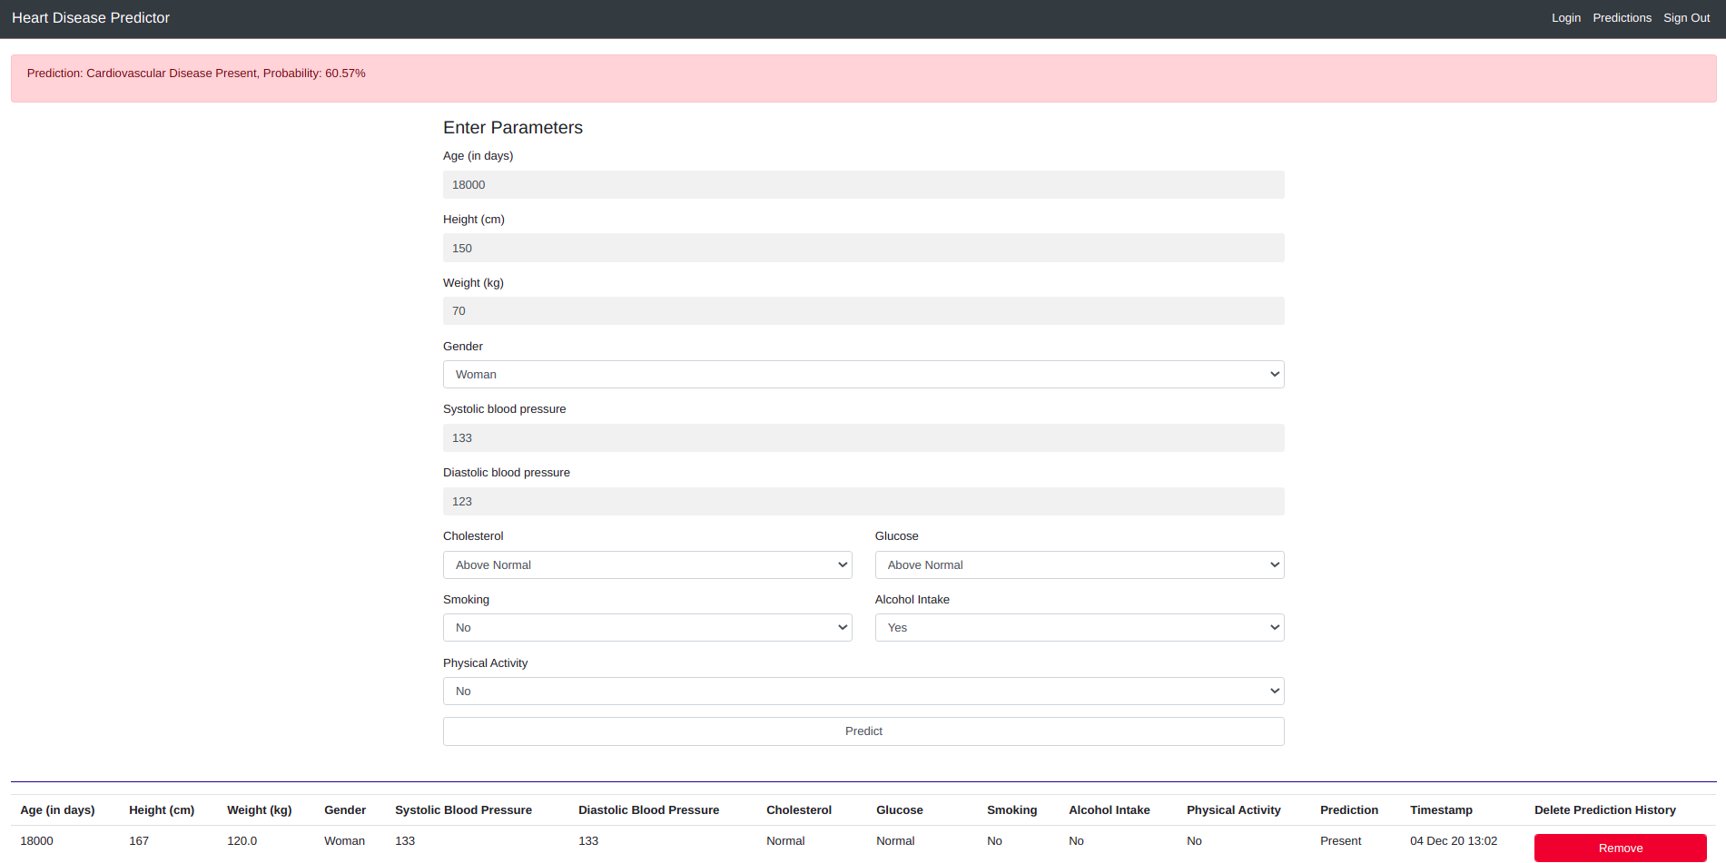
Web app
Features: User authorization/Authentication, Prediction History for users, Can delete History, Better model (feature engineering)

